Slide 1

ARC’s årsmøde 2022-23
Sandbjerg gods

Slide 2
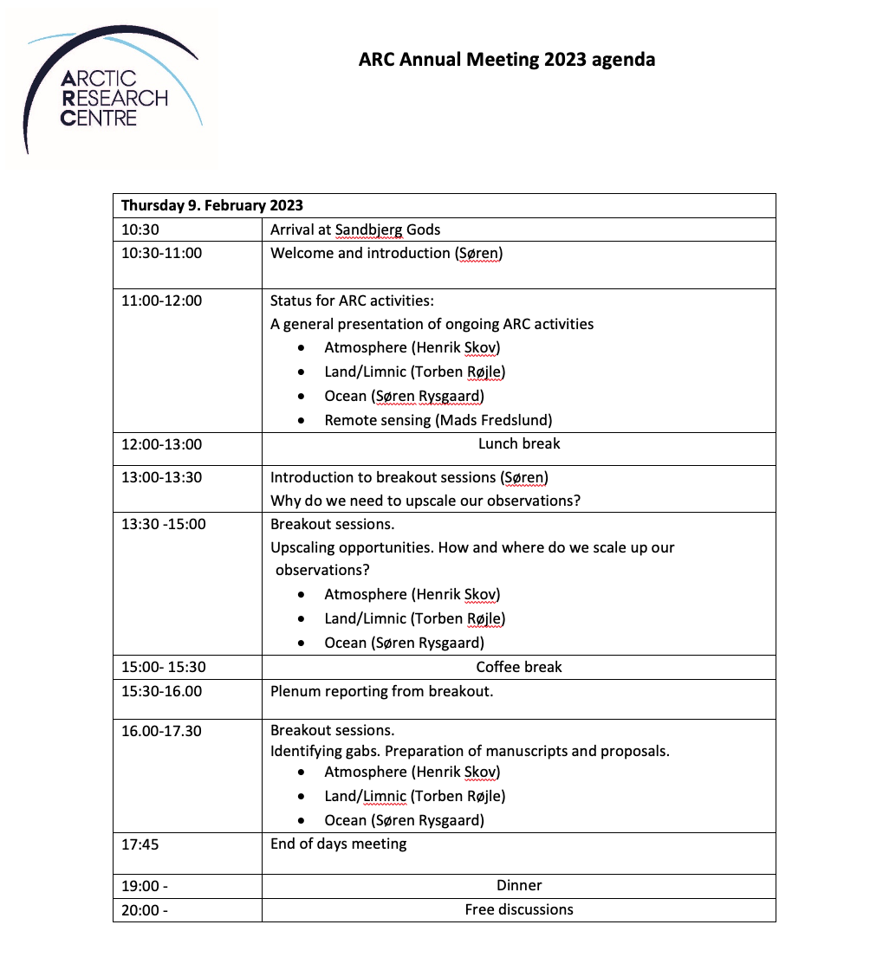
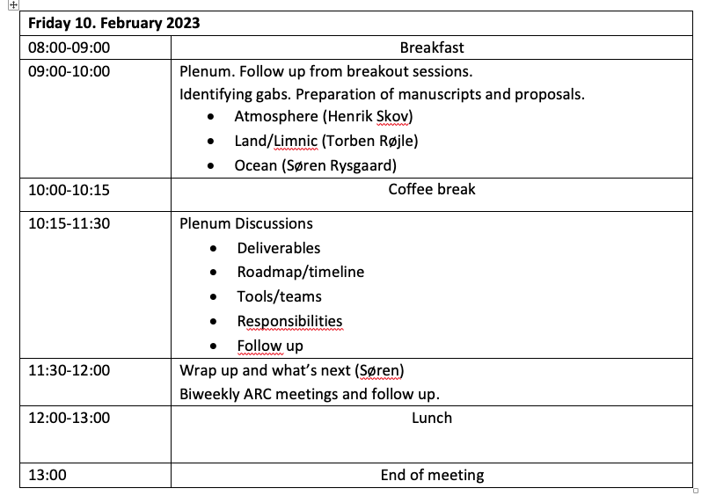
Notes:
Next 3 years.

Slide 3
Summary of breakout sessions: Upscaling Atmosphere
Development of cloud formation particles from iodine and microbial particles
Investigation at different scales:
Frost flower studies in the laboratory (chemistry)
Development of particle size analyser
Autonomous Low-cost sensor pack (electrochemical sensors and particle counter) and met-station.
Placement of new sensor package at GIOS units
Collaboration on dust – Kangerlussuaq
Development of limnic and marine CH4 underwater sensor – drone deployment in front of glaciers
Vertical resolution of climate forces and pollutants.

Slide 4
Summary of breakout sessions: Upscaling Land/Limnic
(1) Upscaling DIN and DON flux from land to coastal water.
(2) GHG emission from freshwater systems under warming climate
Developing a model concept based on long-term datasets in Greenland (Zaxckenberg/Kobbefjord)
Investigating data gabs (lakes and unvegetated soils
Implementing gas flux measurements using chambers and new CH4 sensors.
Test ice core CH4 profiles and thermistor strings for CH4 emission from autumn to spring
Developing emission model for upscaling
Building out GIOS systems

Slide 5
Summary of breakout sessions: Upscaling Ocean
Where is the water around Greenland coming from?
Investigation at different scales:
Water isotopes
Proxies (better for AW)
eDNA – reconstruction of growth
Impact of freshwater and eddies
Greenhouse gas dynamics
New sensors and drones (CH4)
Infrared and optical cameras for satellites
Detection of ice thickness and leads - satellite
Glacier morphology - satellite
Upscaling with expansion of GIOS
Marine aerosols and atmosphere

Slide 6
Wrap up – and what next
• Activities – completed before next annual
meeting 2024
• Roadmap/timeline – end 2023
• Responsibilities – see individual tasks
• Follow up –biweekly ARC meetings

Slide 7
Summary of breakout sessions: Upscaling Atmosphere
Development of cloud formation particles from iodine and microbial particles
Three application:
Tina/Dorte Lead an application/activity on frost flowers and biogenic and halogen release
Henrik Lead an application on vertical profile og atmospheric key components for understanding the atmospheric processes and the feedback on climate
Andy/Christian North south gradient from Cap Farewell to Morris Jessup of key CC gasses and on aerosols using “low” cost sensors and small sensors. Absolute and relative impact of natural high dust emission location (proglacial rivers) for availability of cloud forming particles and bioaerosols.

Slide 8
Summary of breakout sessions: Upscaling Land/Limnic
(1) Upscaling DIN and DON flux from land to coastal water. Step1: Modelling paper: Collate data, primiliminary model (Dorte, Tom, Tenna) Step 2: proposal for verify model in other areas (2024) - Tenna
(2) GHG emission from from arctic freshwater systems
Step 1. Effect of dust on lake/stream primary production and GHG emission. Pilot project 2023 – Tom and Christian. Collect water samples for GHG concentration and water chemistry,
Step 2. Climate feedback (GHG emission) along a north-south gradient in Greenland. Proposal (Tom, Tenna….) 2023-24. DFF FP2.

Slide 9
Summary of breakout sessions: Upscaling Ocean
Prioritized ideas
CH₄ detection – methods for upscaling (proposal) – Josefa/Eugeinio/Ebbe/Christian
Sensors development – placement in GIOS and use with drones
Satellite - provide ground truth to ongoing GIOS project
Methane hydrates
Proxies for water mass identification (workshop-literature study) – Jakob/Henrika
O18 in bivalves, pilot experiment. Historical record examination.
Remote sensing from space (connecting students to DISCO2) – point of contact Andreas
Which resolution, field size ?

